Slide 1
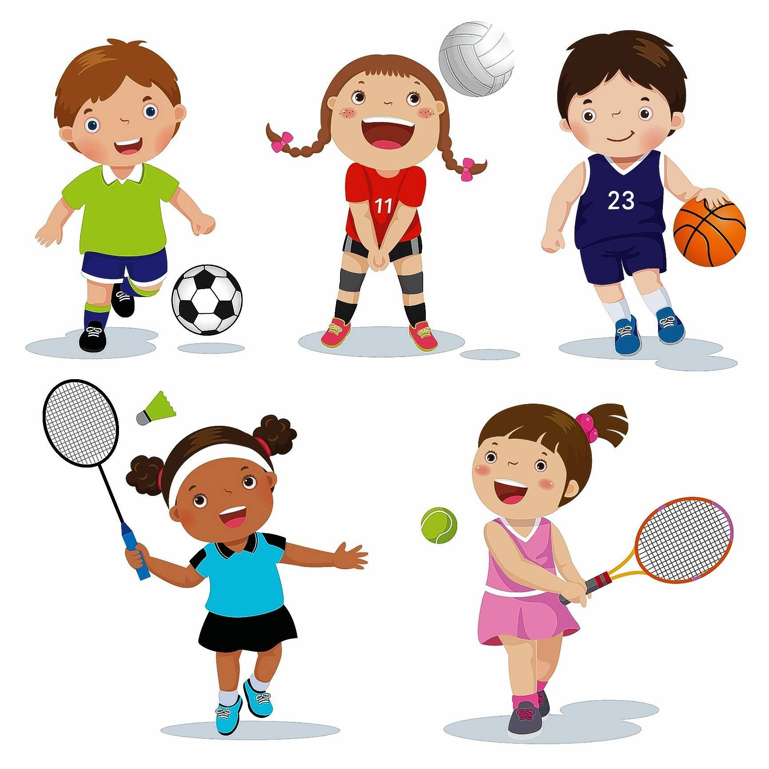
AT THE SPORTS CENTRE

Slide 2
dancing - ples

Slide 3
swimming - plavanje

Slide 4
skateboarding - rolkanje

Slide 5
basketball –košarka

Slide 6
tennis –tenis

Slide 7
football - nogomet

