Slide 1
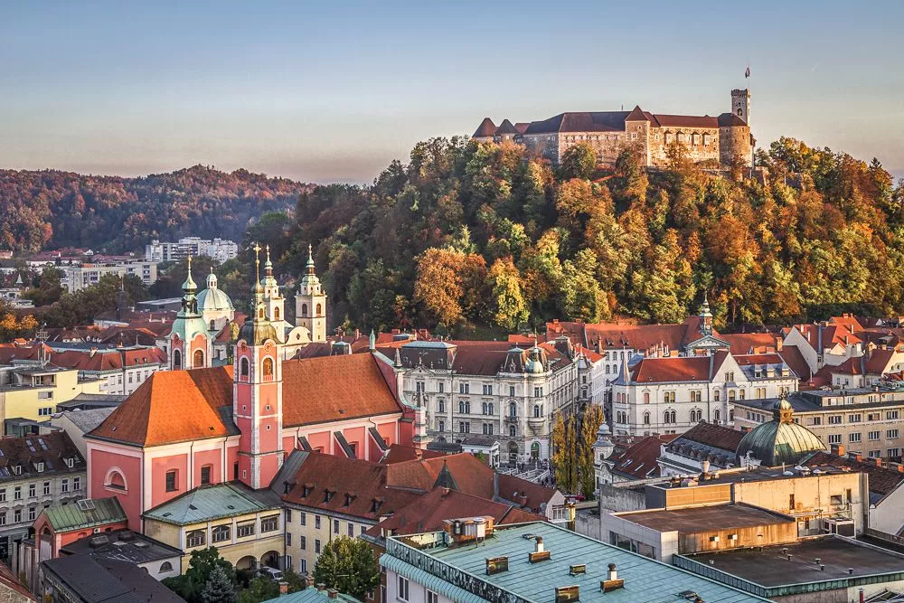
MY TOWN

Slide 2
a station - postaja

Slide 3
a shop - trgovina

Slide 4
a hospital - bolnišnica

Slide 5
a church - cerkev

Slide 6
a hotel - hotel

Slide 7
a bank - banka

Slide 8
a cinema - kino

