Slide 1
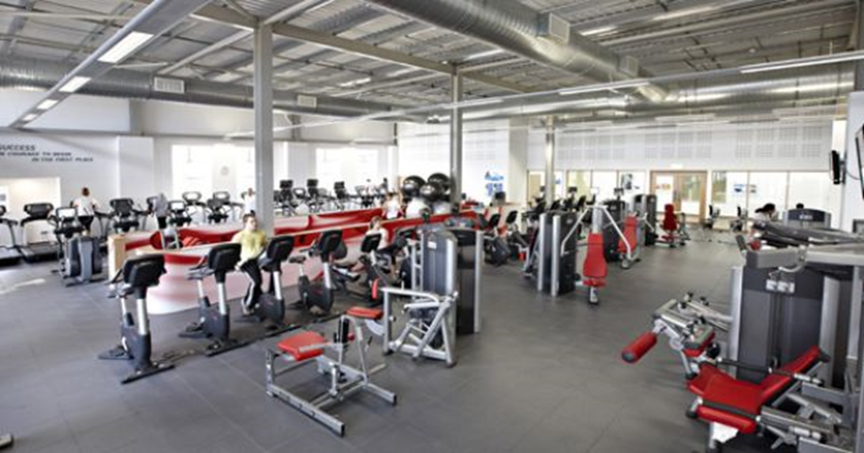
a sports centre – športni center

Slide 2
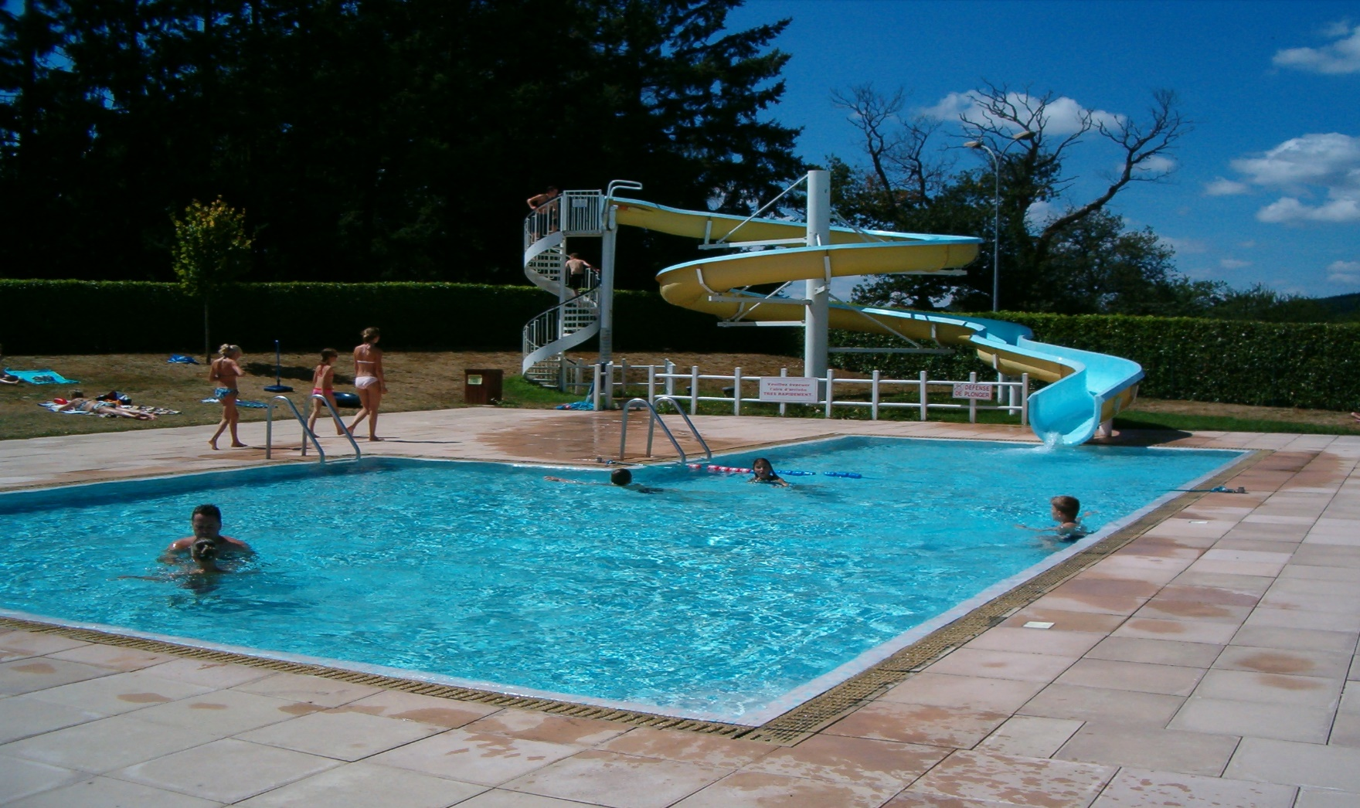
a swimming pool – plavalni bazen

Slide 3
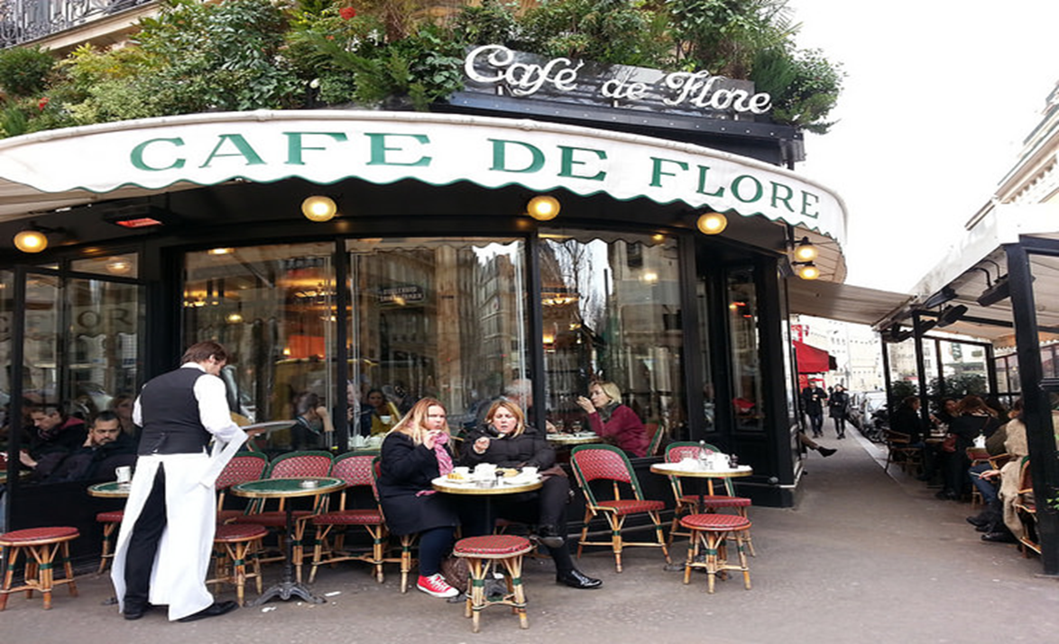
a café - kavarna

Slide 4
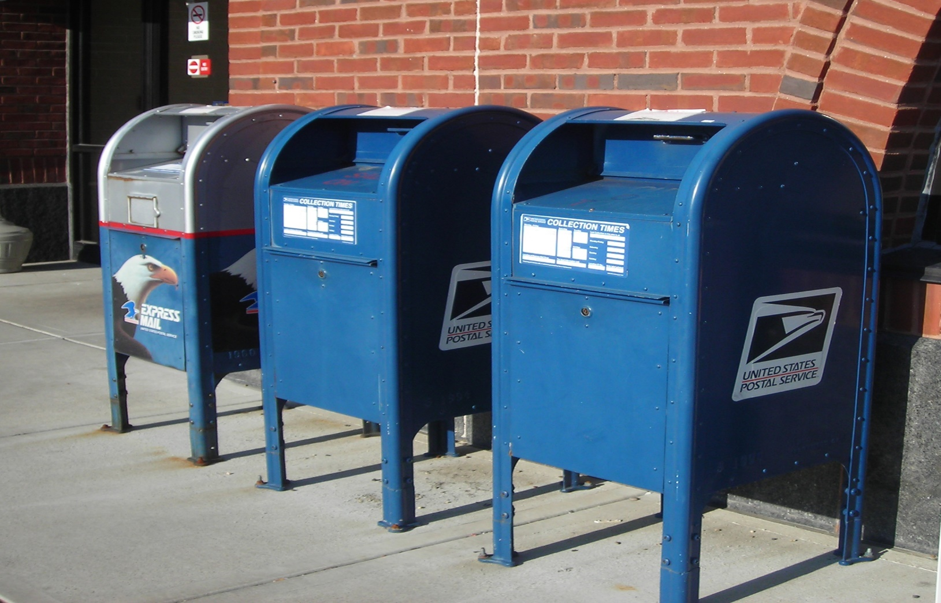
a post office - pošta

Slide 5
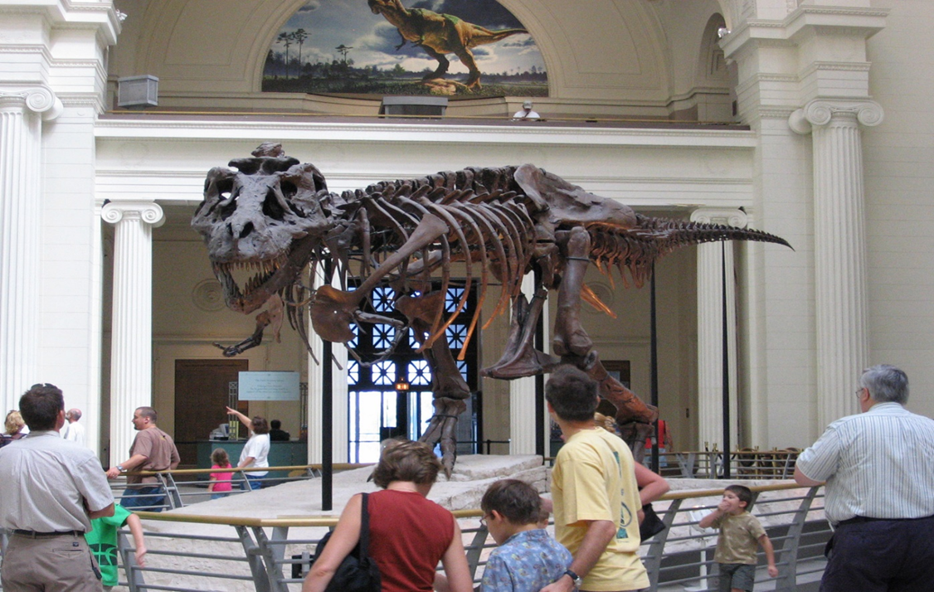
a museum - muzej

Slide 6
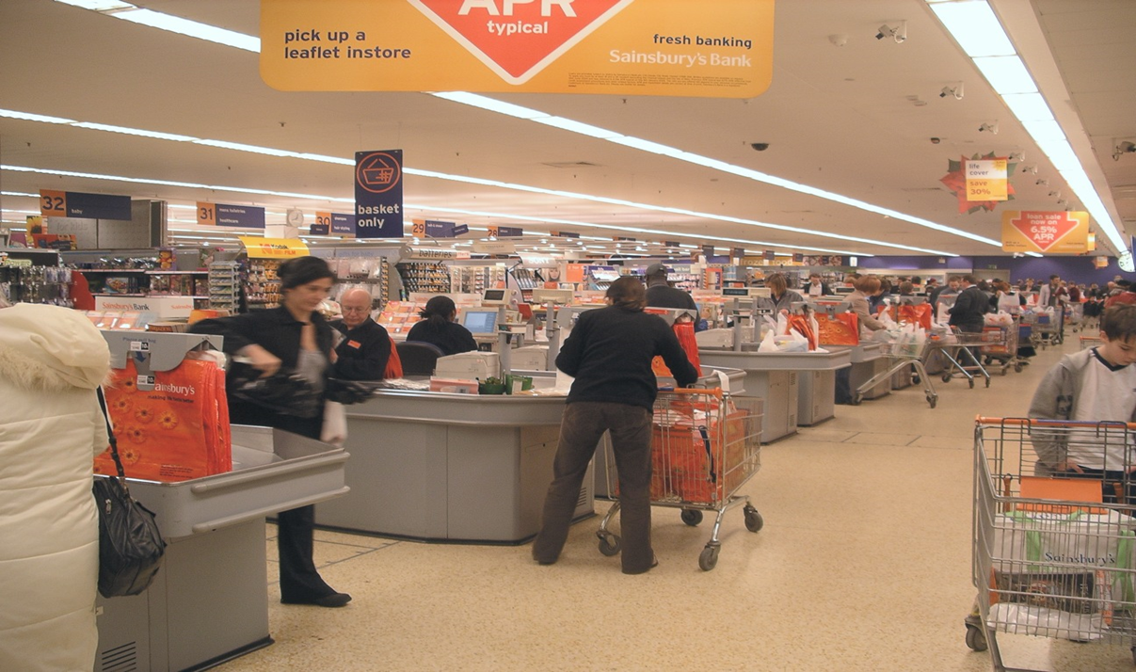
a supermarket – samopostrežna trgovina

Slide 7
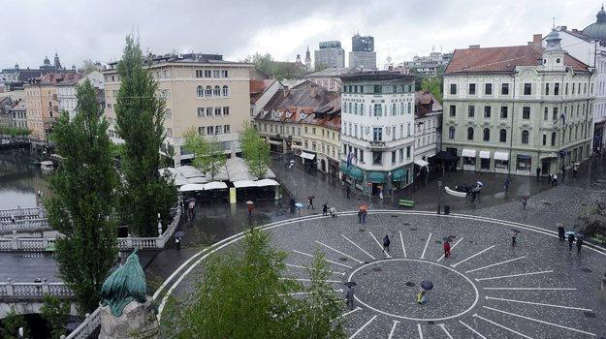
a square - trg

