Slide 1
ADJECTIVES - PRIDEVNIKI

Slide 2
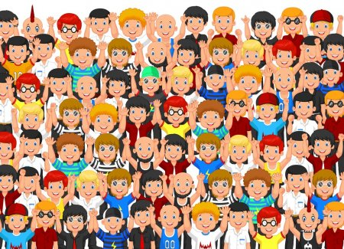
crowded – gneča (ljudi)

Slide 3

expensive - drag

Slide 4

cheap - poceni

Slide 5

hilly - hribovit

Slide 6

flat - raven

Slide 7

beautiful - lep

Slide 8

wide - širok

Slide 9

difficult – težek, zahteven

Slide 10
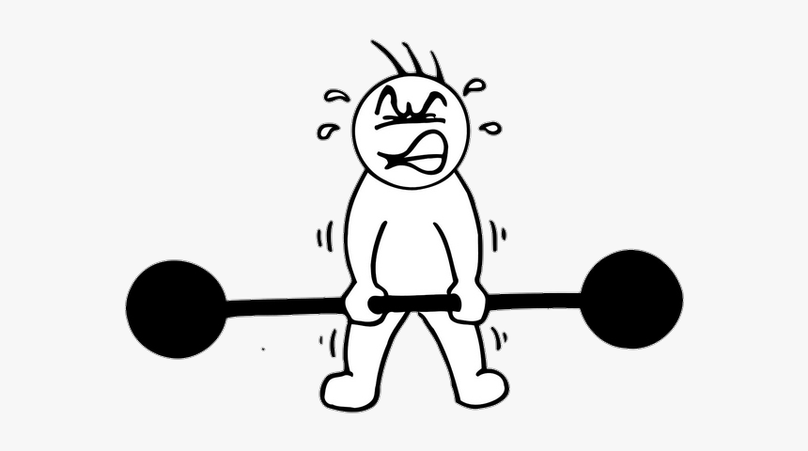
heavy - težek

Slide 11
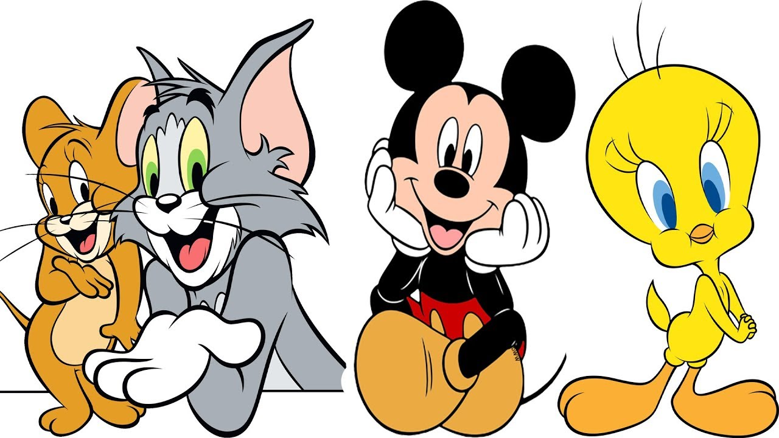
famous - slaven

Slide 12

friendly - prijazen

