Slide 1
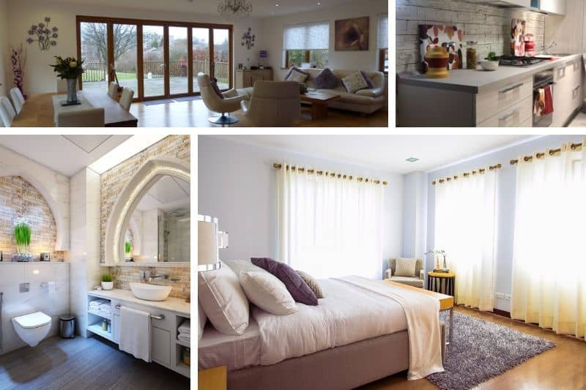
ROOMS

Slide 2
hall – hodnik, predsoba

Slide 3
kitchen - kuhinja

Slide 4
living room – dnevna soba

Slide 5
dining room - jedilnica

