Slide 1
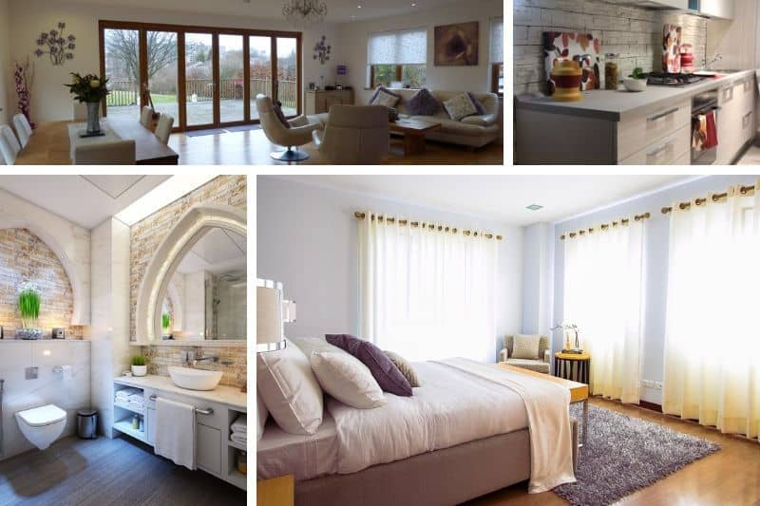
ROOMS

Slide 2
bathroom - kopalnica

Slide 3
toilet - stranišče

Slide 4
bedroom - spalnica

Slide 5
cellar – klet

Slide 6
garage - garaža

Slide 7
garden - vrt

