Slide 1
JOBS

Slide 2
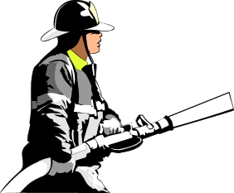
a firefighter - gasilec

Slide 3
a cook - kuhar

Slide 4
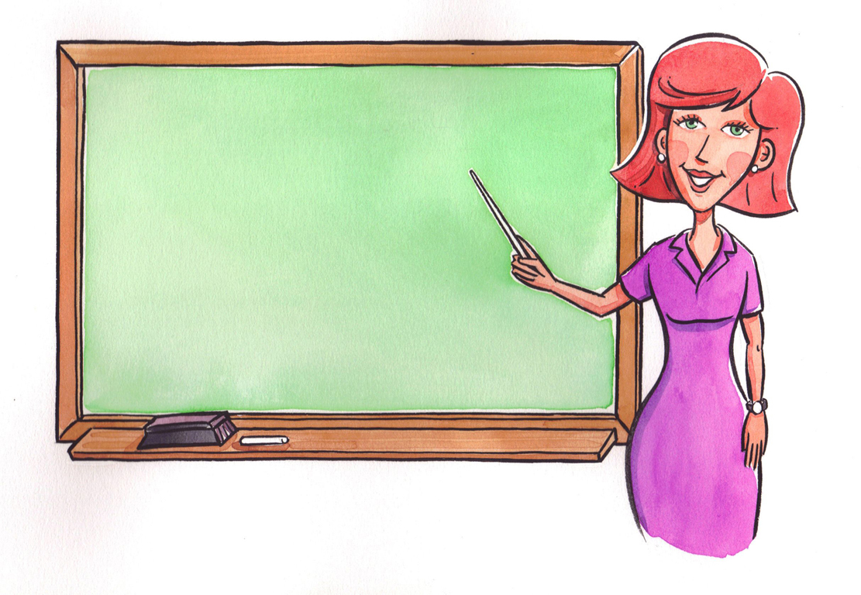
a teacher - učitelj

Slide 5
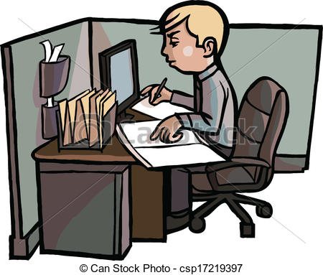
an office worker – pisarniški delavec

Slide 6
a nurse – (medicinska) sestra

Slide 7
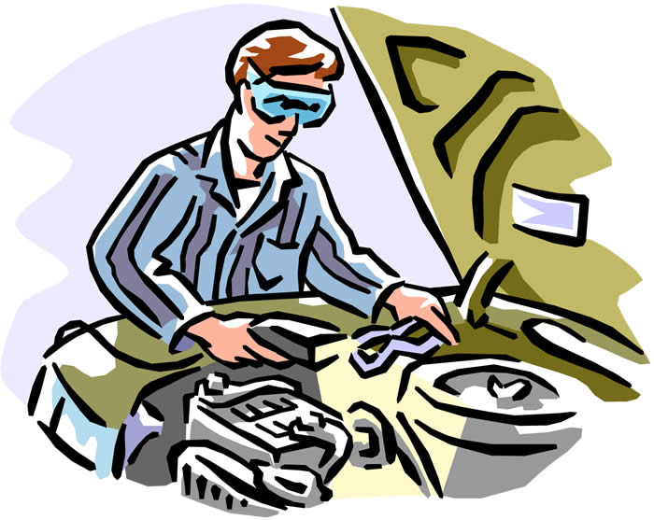
a mechanic - mehanik

