Slide 1
THE UNITED KINGDOM OF GREAT BRITAIN AND NORTHERN IRELAND

Slide 2
THE UK
ENGLAND
SCOTLAND
WALES
NORTHERN IRELAND

Slide 3
ENGLAND

Slide 4
LONDON – the capital of the UK

Slide 5
TOWER BRIDGE

Slide 6
THE THAMES

Slide 7
THE CHANNEL TUNNEL (50km long)

Slide 8
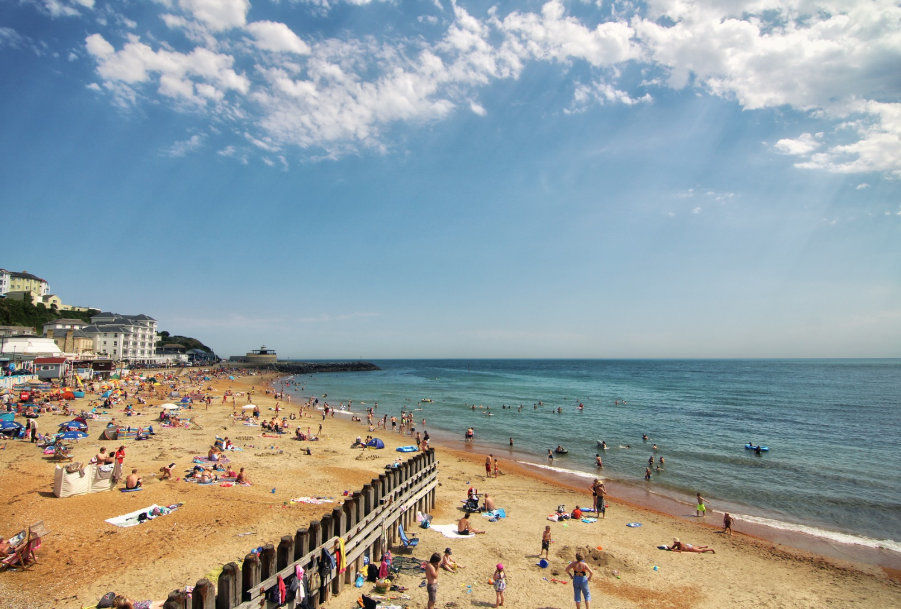
THE ISLE OF WIGHT

Slide 9
SCOTLAND

Slide 10
EDINBURGH – the capital of Scotland

Slide 11
BEN NEVIS – THE HIGHEST MOUNTAIN (1343m)

Slide 12
LOCH NESS (226m deep)

Slide 13
NESSIE – a monster in Loch Ness

Slide 14
WALES

Slide 15
CARDIFF – the capital of Wales

Slide 16
NORTHERN IRELAND

Slide 17
BELFAST – the capital of Northern Ireland

