Slide 1
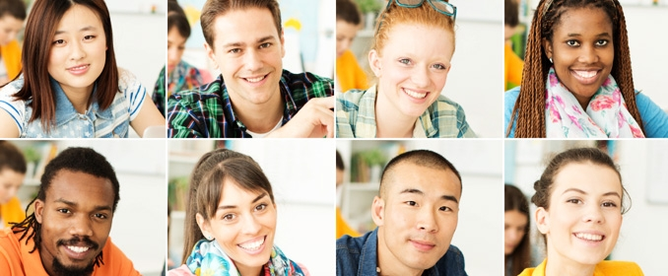
WHAT DO THEY LOOK LIKE?
(Kako izgledajo?)

Slide 2
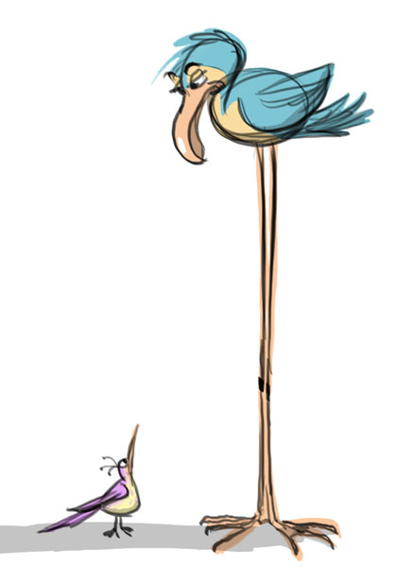
TALL - visok

Slide 3
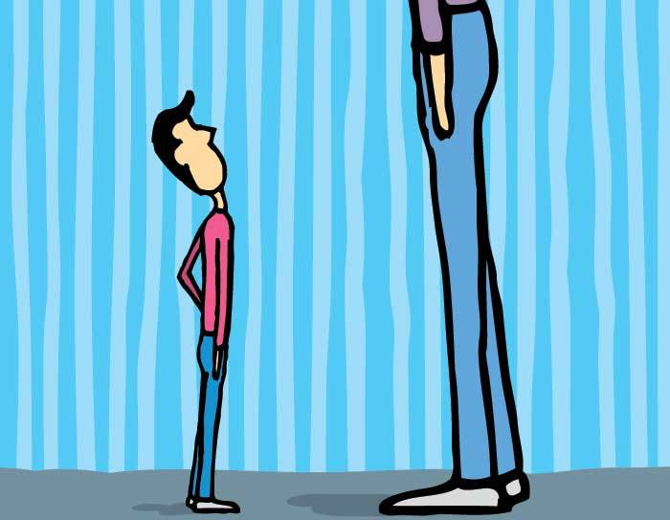
SHORT – kratek / majhen

Slide 4
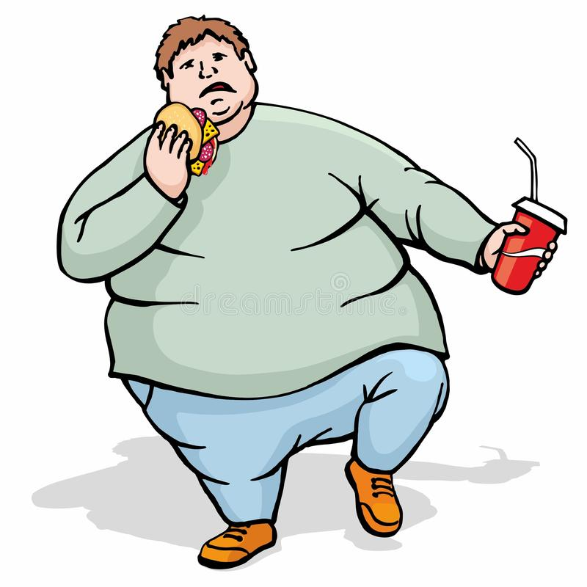
FAT - debel

Slide 5
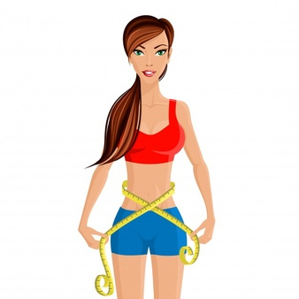
SLIM – vitek / vitka

Slide 6
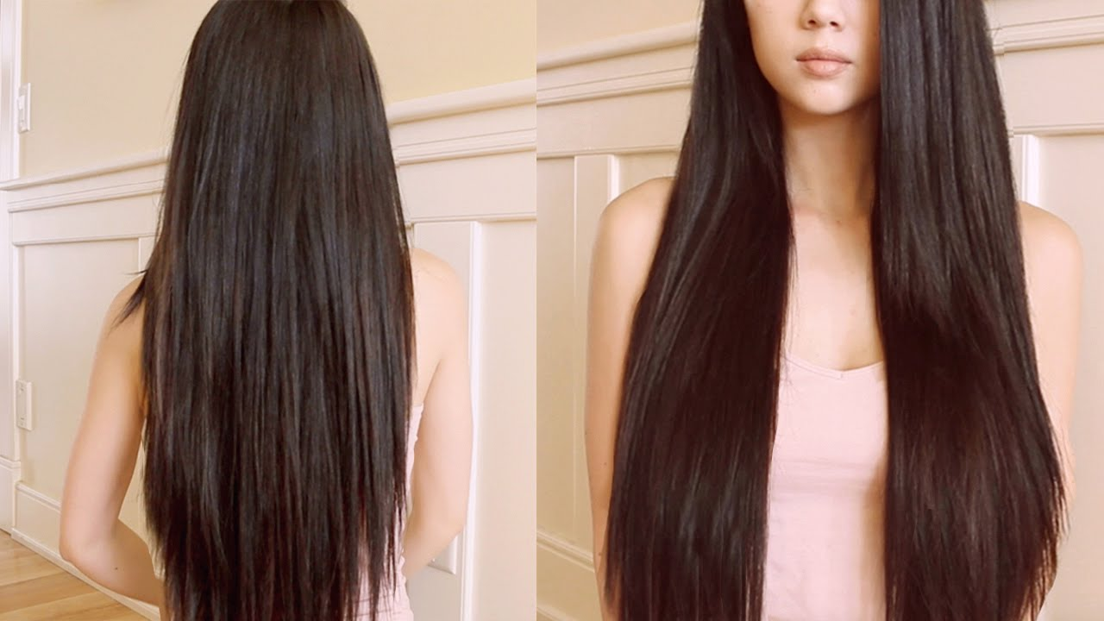
LONG HAIR – dolgi lasje

Slide 7
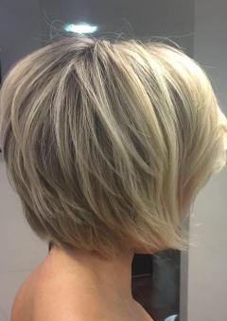
SHORT HAIR – kratki lasje

Slide 8
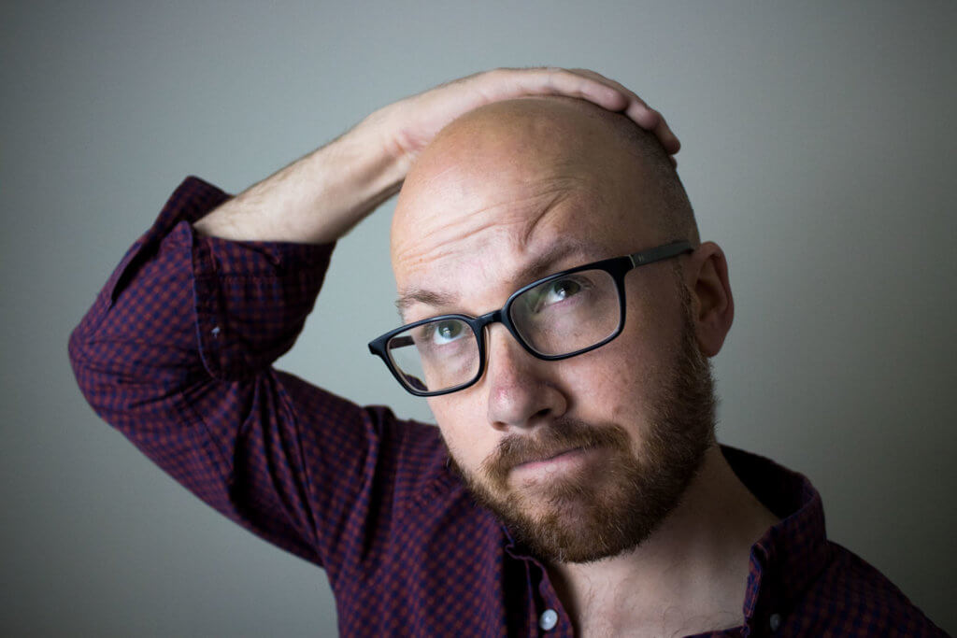
BALD - plešast

Slide 9
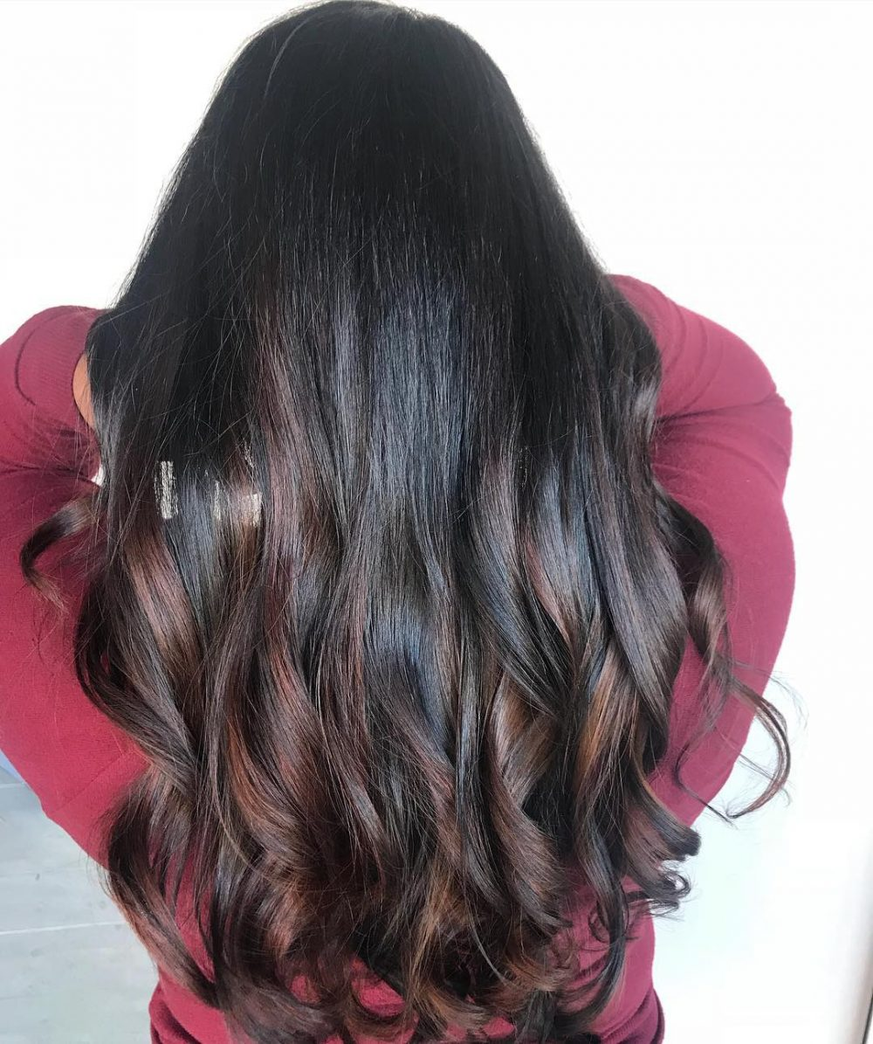
DARK HAIR – temni lasje

Slide 10
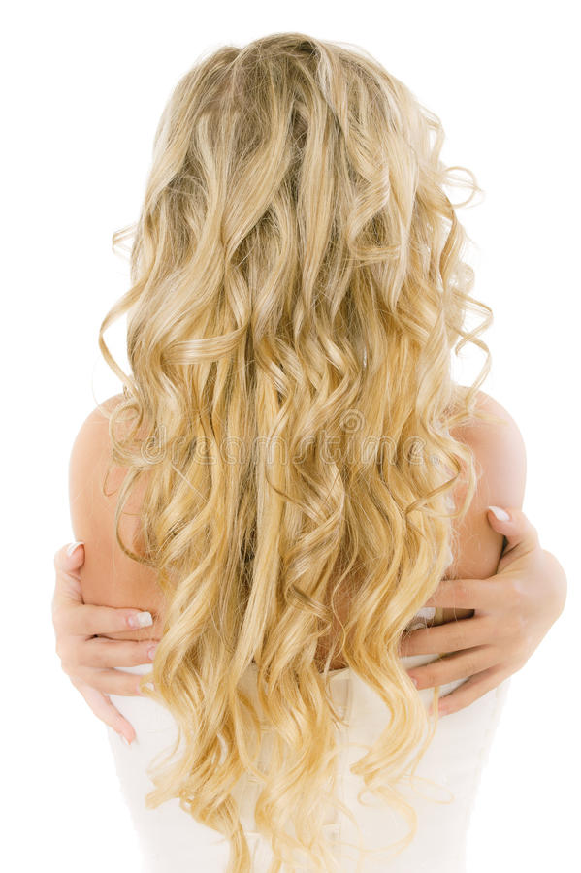
FAIR HAIR – svetli lasje

Slide 11
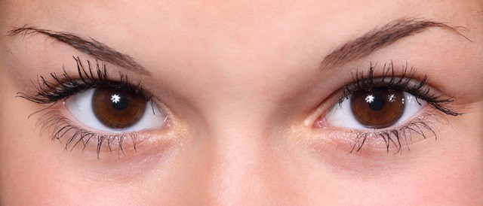
BROWN EYES – rjave oči

Slide 12
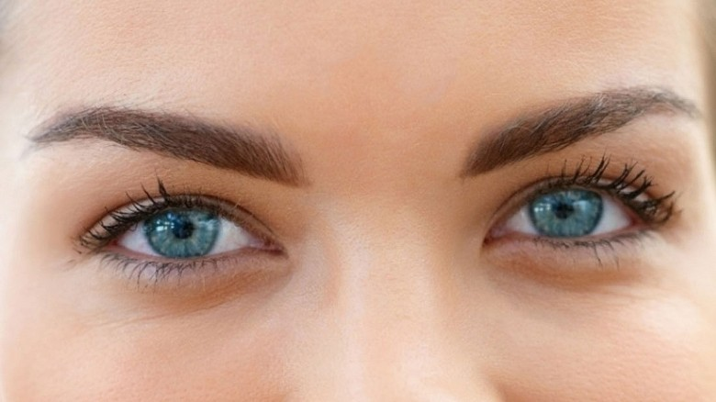
BLUE EYES – modre oči

Slide 13
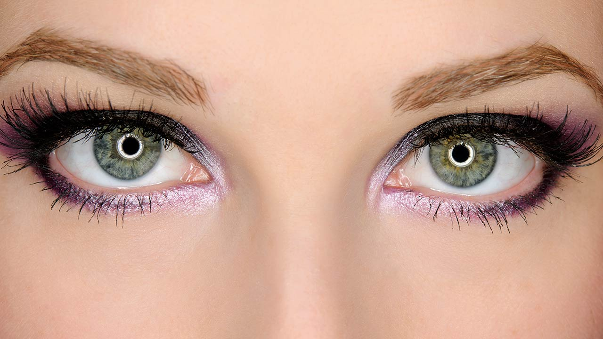
GREEN EYES – zelene oči

Slide 14
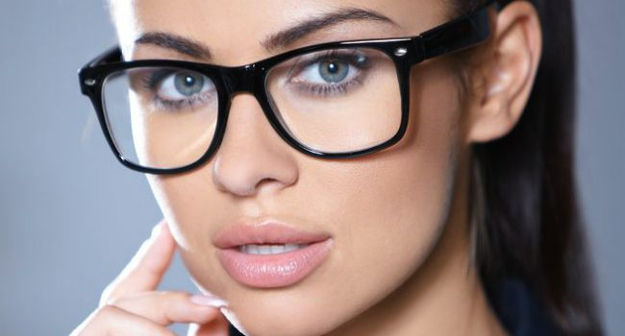
GLASSES - očala

Slide 15
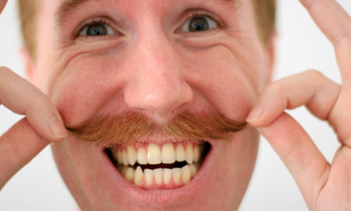
A MOUSTACHE – brki

Slide 16
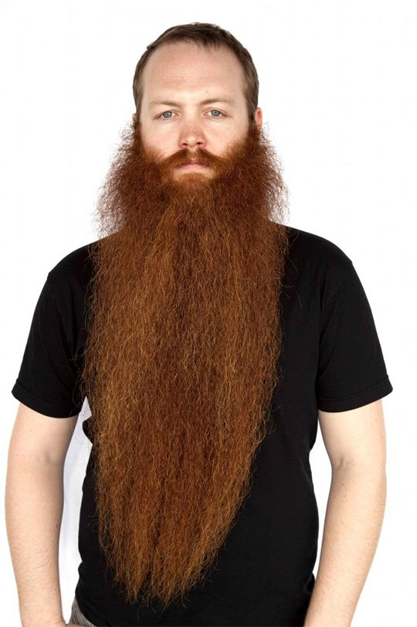
A BEARD - brada

