Slide 1
EXPERIENCES - IZKUŠNJE

Slide 2
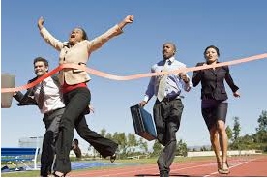
win a race - zmagati na dirki

Slide 3
win a competition - zmagati na tekmovanju

Slide 4
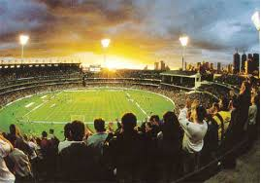
see a sports event – ogledati športni dogodek

Slide 5
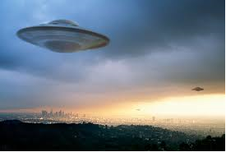
see a UFO – videti NLP

Slide 6
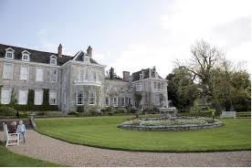
visit a place – obiskati kraj

Slide 7
visit friends – obiskati prijatelje

Slide 8
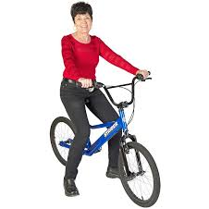
ride a bike – voziti se s kolesom

Slide 9
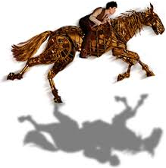
ride a horse – jahati konja

Slide 10
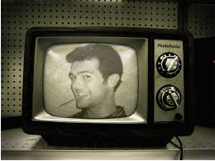
be on TV – biti na TV

Slide 11
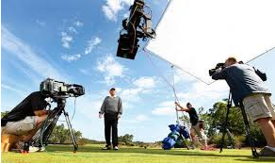
be in a film – nastopati v filmu

Slide 12
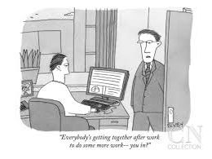
do some work – opraviti nekaj dela

Slide 13
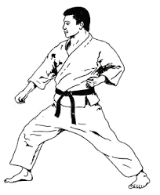
do karate – trenirati karate

