Slide 1
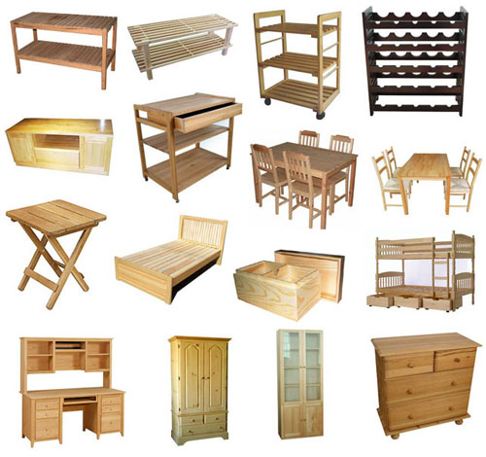
FURNITURE POHIŠTVO

Slide 2
curtains - zavese

Slide 3
a sofa - kavč

Slide 4
a table- miza

Slide 5
an armchair - naslanjač

Slide 6
a sink – pomivalno korito

Slide 7
a fridge - hladilnik

Slide 8
a cooker - štedilnik

Slide 9
a cupboard - omara

Slide 10
a light - luč

Slide 11
a shower - tuš

Slide 12
a bath - banja

Slide 13
a toilet - straniščna školjka

